Slide 1
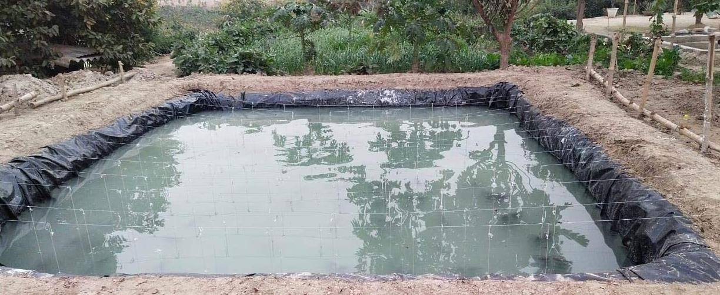
Get the Top Quality Pond Lining Sheets with Best Pricing
Imagine the tranquil beauty of a pond, nestled in your garden or landscape, reflecting the clear blue sky and teeming with vibrant aquatic life. Achieving this picturesque vision requires more than just digging a hole and filling it with water. The key to a thriving pond lies beneath the surface, where a carefully chosen pond lining sheet ensures watertight integrity, prevents seepage, and creates a stable aquatic environment. In this article, we'll explore the world of pond lining sheets, highlighting their significance, types, benefits, and how they play a pivotal role in the creation and maintenance of your aquatic oasis.
The Importance of Pond Lining Sheets
Pond lining sheets are the unsung heroes of your water feature project, providing a reliable foundation for your aquatic oasis. Here's why they are crucial:
Leak Prevention: Without a pond lining sheet, water can seep into the ground, causing your pond to lose water constantly. This can be not only frustrating but also costly to constantly replenish.
Water Quality: Pond lining sheets help maintain water quality by preventing contaminants, such as pesticides, fertilizers, and pollutants, from leaching into the pond from the surrounding soil. This is essential for the health of aquatic life.
Aquatic Life Support: These sheets create a stable and healthy environment for fish, plants, and other aquatic organisms. By maintaining consistent water parameters, they ensure that your pond's
ecosystem thrives.

Slide 2
Aesthetic Value: Beyond their functional importance, pond lining sheets offer a clean and polished finish. They create the foundation for a beautiful, reflective surface that enhances the overall
aesthetic appeal of your pond.
Types of Pond Lining Sheets
Several types of pond lining sheets are available, each tailored to specific needs and preferences:
Rubber Pond Liners (EPDM): Ethylene Propylene Diene Monomer (EPDM) rubber pond liners are known for their durability, flexibility, and resistance to UV rays. They are suitable for irregularly shaped ponds and water gardens.
PVC Pond Liners: Polyvinyl chloride (PVC) pond liners are cost-effective and easy to install. They come in various thicknesses and are suitable for both small and medium-sized ponds.
Butyl Pond Liners: Butyl rubber pond liners offer excellent flexibility and resistance to temperature fluctuations. They are often preferred for koi ponds and formal garden ponds.
HDPE Pond Liners: High-Density Polyethylene (HDPE) pond liners are known for their strength and resistance to punctures and tears. They are commonly used in larger commercial ponds and
reservoirs.
Benefits of Pond Lining Sheets
Leak Prevention: Pond lining sheets provide a reliable barrier against water leakage and seepage, preventing costly water loss.
Longevity: High-quality pond lining sheets can last for decades, reducing the need for frequent repairs or replacements.
Versatility: Pond lining sheets can be customized to fit the shape and size of your pond, making them suitable for both small garden ponds and large agricultural reservoirs.
Protection: They protect your pond's ecosystem by preventing contaminants from infiltrating the water.

Slide 3
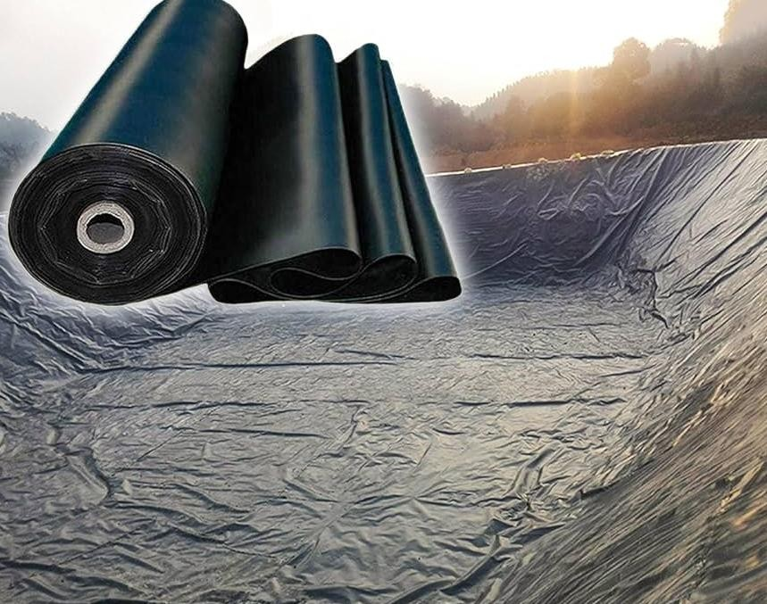
Aesthetic Appeal: Pond lining sheets create a clean and polished appearance for your pond, enhancing its visual appeal and creating a beautiful focal point in your landscape.
Installation Tips for Pond Lining Sheets
Proper installation is crucial to the effectiveness of your pond lining sheet:
Site Preparation: Thoroughly prepare the pond site by removing sharp rocks, roots, and debris.
Underlayment: Install an underlayment beneath the pond lining sheet to protect it from punctures and damage.
Secure the Edges: Ensure that the pond lining sheet has enough overlap and is securely anchored to prevent shifting.

Slide 4
Smooth Out Wrinkles: Gradually fill the pond with water, smoothing out wrinkles and air pockets as it fills.
Regular Maintenance: Periodically inspect your pond lining for signs of wear, punctures, or damage. Promptly repair any issues to prevent water loss or contamination.
Additional Benefits of Pond Lining Sheets:
Ease of Maintenance: Pond lining sheets simplify maintenance tasks. They create a contained
environment, making it easier to remove debris, algae, and other unwanted elements from your pond's surface. This promotes healthier water quality and reduces the effort required to keep your pond looking pristine.
Controlled Water Levels: Pond lining sheets allow you to have greater control over water levels. This is especially valuable in regions with fluctuating water tables or during dry spells when water conservation is essential. You can adjust the water level to suit the needs of your pond's inhabitants and aesthetic preferences.
Preventing Soil Erosion: In addition to preventing water seepage, pond lining sheets protect the surrounding soil from erosion caused by water movement. This safeguards the structural integrity of your pond and prevents sediment runoff into nearby water bodies.
Aquatic Plant Growth: Pond lining sheets create a stable environment for aquatic plants by
preventing them from taking root in the surrounding soil. This control over plant growth allows you to design and maintain your pond's aesthetics effectively.
Considerations When Selecting Pond Lining Sheets:
Size and Shape: Measure and determine the size and shape of your pond accurately. Customizing the pond lining sheet to fit these dimensions is crucial for proper installation and effectiveness.
Thickness: Pond lining sheets are available in various thicknesses. Thicker sheets offer increased durability and puncture resistance, making them suitable for ponds with rough or rocky substrates.
Material Compatibility: Consider the compatibility of the chosen pond lining material with the aquatic life you intend to keep. Some materials may release harmful chemicals into the water, which can be detrimental to fish and plants.

Slide 5
Professional Installation: While it's possible to install pond lining sheets as a DIY project, professional installation ensures a seamless and secure fit. Pond experts can handle irregular shapes and
challenging terrains, ensuring that your pond remains watertight.
Longevity: Invest in a high-quality pond lining sheet with a long lifespan. While the initial cost may be higher, it can save you money and effort in the long run by reducing the need for frequent
replacements.
UV Resistance: If your pond is exposed to direct sunlight, consider pond lining sheets with UV
resistance. UV-stabilized liners are designed to withstand prolonged exposure to the sun, extending their lifespan.
Local Regulations: Be aware of any local regulations or permits required for installing a pond lining sheet. Depending on your location and the size of your pond, there may be specific requirements to adhere to.
Additional Benefits of Pond Lining Sheets:
Ease of Maintenance: Pond lining sheets simplify maintenance tasks. They create a contained
environment, making it easier to remove debris, algae, and other unwanted elements from your pond's surface. This promotes healthier water quality and reduces the effort required to keep your pond looking pristine.
Controlled Water Levels: Pond lining sheets allow you to have greater control over water levels. This is especially valuable in regions with fluctuating water tables or during dry spells when water conservation is essential. You can adjust the water level to suit the needs of your pond's inhabitants and aesthetic preferences.
Preventing Soil Erosion: In addition to preventing water seepage, pond lining sheets protect the surrounding soil from erosion caused by water movement. This safeguards the structural integrity of your pond and prevents sediment runoff into nearby water bodies.
Aquatic Plant Growth: Pond lining sheets create a stable environment for aquatic plants by
preventing them from taking root in the surrounding soil. This control over plant growth allows you to design and maintain your pond's aesthetics effectively.

Slide 6
Considerations When Selecting Pond Lining Sheets:
Size and Shape: Measure and determine the size and shape of your pond accurately. Customizing the pond lining sheet to fit these dimensions is crucial for proper installation and effectiveness.
Thickness: Pond lining sheets are available in various thicknesses. Thicker sheets offer increased durability and puncture resistance, making them suitable for ponds with rough or rocky substrates.
Material Compatibility: Consider the compatibility of the chosen pond lining material with the aquatic life you intend to keep. Some materials may release harmful chemicals into the water, which can be detrimental to fish and plants.
Professional Installation: While it's possible to install pond lining sheets as a DIY project, professional installation ensures a seamless and secure fit. Pond experts can handle irregular shapes and
challenging terrains, ensuring that your pond remains watertight.
Longevity: Invest in a high-quality pond lining sheet with a long lifespan. While the initial cost may be higher, it can save you money and effort in the long run by reducing the need for frequent
replacements.
UV Resistance: If your pond is exposed to direct sunlight, consider pond lining sheets with UV
resistance. UV-stabilized liners are designed to withstand prolonged exposure to the sun, extending their lifespan.
Local Regulations: Be aware of any local regulations or permits required for installing a pond lining sheet. Depending on your location and the size of your pond, there may be specific requirements to adhere to.
In summary, pond lining sheets are essential for creating and maintaining a thriving aquatic ecosystem in your pond or water feature. They provide numerous benefits, including leak
prevention, water quality maintenance, and ease of maintenance. By selecting the right pond lining material, ensuring proper installation, and conducting regular inspections, you can enjoy the beauty and serenity of your pond for years to come. Pond lining sheets are the blueprint for a perfectly sealed oasis, ensuring that your aquatic paradise remains a source of joy and tranquility.

